Slide 1
Process Concept Module 3
Operating Systems
Nadia Qureshi

Slide 2
Module Outline
Process Concept
Program vs Process
Process Control Block
Process Table
Context Switch
Process states
Process states transitions
Process life cycle
Five state process model
Unix process state transition diagram

Slide 3
Process Concept
A process is basically a program in execution
or that which a processor executes
A process is unit of work in a system
A process is an activity performed by a system
It may be program’s data, program counter, pointer or register used in a program
A process uses resources like CPU, memory, files and I/O devices
Operating system processes execute system code and user processes executes user code

Slide 4
What is Program in OS?
When we write and compile the code, we get an executable file. The executable file which gets created is known as a program. The executable file created has all the instructions or the code within it. The file will be inactive unless we execute it that's why a program is a passive entity.
A program is a system activity that has a set of instructions, and it performs a specific task. In batch processing systems it is known as executing jobs and in the real-time operating system, it is known as a program. A user can run many programs simultaneously. Edge.exe, notepad.exe, or any executable files are examples of programs.

Slide 5
What is Process in OS?
When we execute a program, it is known as a process. The process executes all the lines of code in the program. A process can create another process, delete another process or it can schedule another process as per the codes written in the program.
When a program is executed, a process is started, and it needs memory address, CPU, and I/O devices while it is running. A process is responsible for performing specified tasks written in the program. For example, when we double click on Edge.exe, this will execute an instance of the program and the Edge browser will start running, this is a process.

Slide 6
Program vs Process
A program is a passive entity
A process is a dynamic entity represented by the values stored in registers, memory, program counters etc.
A program does not compete for the computing resources whereas a process does
The major difference between process and program is that a process cannot exist without a program, whereas a program can exist independently.
Another difference between process and program is that a process is an instance of a program getting executed.
One program can have several processes
Consider multiple users executing the same program

Slide 7
Process Control Block (PCB)
Doubly linked list
When a new user program is initiated
OS creates a data structure, called Process Control Block (PCB), which gives substance to the process and serves to control it
Each process is represented by its own process control block
PCB is a data block or record containing information associated with a specified process
Allows the OS to locate all key information about a process
When the OS switches the attention of the CPU among various active processes
It uses the same area in PCB to hold the information
That information used to restart process when the process next gets CPU
Process control block is also called task control block

Slide 8
Process Control Block (PCB)
PCB contains following information about process
Current state of the process
Unique identification of process
A pointer to process parent
Pointer to process’s child processes
The process’s priority
Pointer to locate the process memory
Pointer to allocated resources
The register save area – CPU register
The processor it is running on
Accounting information
I/O state information

Slide 9
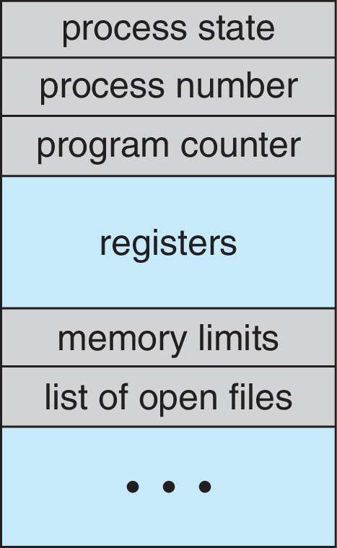
Process Control Block (PCB)

Slide 10
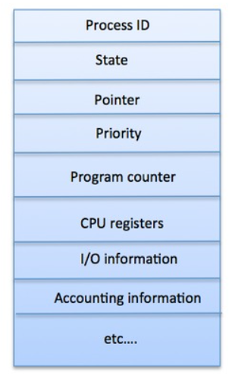
Process Control Block (PCB)
The architecture of a PCB is completely dependent on Operating System and may contain different information in different operating systems. Here is a simplified diagram of a PCB −
The PCB is maintained for a process throughout its lifetime, and is deleted once the process terminates.

Slide 11
Process Table
OS maintains the process table with one entry per process
This entry contains information about process’s
state
its program counter
stack pointer
memory allocation
the status of its open file
its accounting and scheduling information
its priority

Slide 12
The Shell
It is a command interpreter
It is a process which starts by typing a command at prompt
It provides an interface to the OS for the user
A facility for online users rather than batch
Command can be entered
directly at an online terminal
through shell program or script
a text file having series of commands forms a script
DOS shell is alternative as screen-oriented interface

Slide 13
The Shell
In Unix when any user login in, a shell is started up
It starts up as soon as user types some thing at command prompt, e.g. date
The shell creates a child process and run the date program
When child is running shell waits for its termination
When child finishes, the shell types $ prompt again and wait for next command

Slide 14
The Shell
Shell Process
First
File studentInfo
Process executing
grep
$ grep First studentInfo

Slide 15
Operations on Process
A system managing processes may perform following operations
Create a process
Destroy a process
Suspend a process
Resume a process
Block a process
Wakeup a process
Dispatch a process
Change process’s priority
Enable a process to communicate with other processes
For long term suspension, process’s resources should be free
Changing the priority of process normally involved modifying the priority value in PCB

Slide 16
Process Creation & Termination
A process may create other processes
When a process creates a new process
The creator process is called the parent process
Created process is called the child process
Act of creating a process is called spawning a process
A child process may share the resources of its parent process

Slide 17
Process Creation & Termination
A parent may wait for its child process to terminate before resuming or may run concurrently with the child process
A child process may run the same program as that of its parent or may run a separate program
In DOS, parent and child process do not run in parallel and parent process will suspend itself till child has finished

Slide 18
Process Creation & Termination
When a process is created the following operations are performed
Process naming (process id)
Creates the process control block
Insert it in process table
Determine the process initial priority
Allocate the process’s initial resources
Allocate the address space to be used by the process
When a process is destroyed following operations are performed
Its resources are returned to the system
Its process control block is erased
It is purged from any system list or table

Slide 19
Reasons for Process Creation
New batch job
In a batch environment, a process is created in response to the submission of a job
Interactive log on
A user at a terminal logs on to the system
Created by OS to provide a service
OS can create a process to perform a function on behalf of a user program, without user having to wait, e.g. printing
Spawned by existing process
A user program can create a number of processes
Typically related processes need to communicate and cooperate each other
Achieving this cooperation is a difficult task for the programmer of OS

Slide 20
Reasons for Process Termination
There must be some means for a process to indicate its completion
A batch job should include a halt instruction, which generates an interrupts to alert the OS that a process has completed
For an interactive application, the action of the user will indicate whether the process is completed

Slide 21
Reasons for Process Termination
Following are the possible reasons for process termination;
Normal termination
The process executes an OS service call to indicate that it has completed running
Time limit exceeds
The process has run longer than the specified total time limit which includes
total time elapsed
amount of time spent executing
in case of interactive process, the amount of time since the user last provided any input
Memory unavailable
The process requires more memory than the system can provide

Slide 22
Reasons for Process Termination
Bounds violation
The process tries to access the memory locations that is not allowed to access
Protection error
The process attempt to use a file that is not allowed to use or,
It tries to use it in improper fashion, such as writing to a read only file
Arithmetic error
The process tries a prohibited computation such as division by zero
Time overrun
The process has waited longer than specified maximum for a certain events to occur

Slide 23
Reasons for Process Termination
I/O failure
An error occur in input or output, such as
inability to find a file
failure to read a write after a specified maximum no of tries (when, e.g. a defective area is encountered on a diskette) or
invalid operation (such as reading from the line printer)
Invalid instruction
The process attempts to execute a non-existent instruction (often a result of branching into a data area and attempting to execute data)
Privileged instruction
The process attempts to use an instruction reserved for the operating system

Slide 24
Reasons for Process Termination
Data misuse
A piece of data is of the wrong type or is not initialized
OS or operator intervention
For some reason, the operator or the OS has terminated the process (e.g. if a deadlock exists)
Parent termination
When a parent terminates, the OS should be design to automatically terminate all the offspring of that parent
Parent request
A parent process typically has the authority to terminate any of its offspring

Slide 25
Process States
A process may have the following three states
2. Running
Instructions are being executed
3. Waiting/Blocked
The process is waiting for some event to occur (may be I/O completion)
1. Ready
The process is waiting to be assigned to processor
At any instant a process is in one and only one of three states
Process entering the system must go initially into the ready state
Process can only enter the running state via the ready state
Many OS are constructed using only these three states
However, there is good justification for adding additional states to the model

Slide 26
Process States
New
Process arrival
I/O Completion
Ready
Blocked
Scheduling
Interrupt /
Time expired
I/O request
Running
Terminated
Process terminates

